Slide 1

  Defeating DEP,
  the Immunity Debugger way
  Pablo Solé
  Immunity
Notes:
Hacking is a natural monopoly. This talk examines the reasons for this and how this affects the way information security technologies are evolving. How much will it cost you to own the entire Internet? What is information dominance?
Why do certain technologies fail?
Case study: NIST Static Analysis

Slide 2
Old School Stack Overflow
Stack Memory
Stack Memory
Buffer
Buffer
.
.
.
.
Saved Frame
PWN!!!
Garbage
Return Address
JMP ESP
Func Args
SHELLCODE
.
.
.
.
.
.
.
.

Slide 3
Data Execution Prevention
Stack Memory
Buffer
.
.
Garbage
JMP ESP
SHELLCODE
stack and heap
are not executable anymore!
.
.
.
.

Slide 4
Return to LIBC 101
Stack Memory
Addr-POP EAX
POP EAX
RETN
VALUE for EAX
Addr-POP ECX
POP ECX
RETN
VALUE for ECX
Function Addr
...
Let's say we want to call a function
that takes the arguments from
registers EAX and ECX
...
...
...
...

Slide 5
Survey of the Landscape
Data Execution Prevention
vs
Immunity Debugger
What I Have
What I Want
What I Must
CPU/Memory Context
Control
EAX=alloc(0x1000, RWX)
memcpy(EAX, shellcode)
jmp(EAX)
Stack String
(that bypass filters)

Slide 6
Some Previous Efforts
EEREAP by eEye
  made a cpu/memory emulator using process snapshots
Return-Oriented Programming by Hovav Shacham
  presented a Turing-complete language using pre-selected opcode sequences (gadgets)
manual efforts
  you can always search your own ret-to-libc pieces manually

Slide 7
An Aside
I need a pop/pop/ret FTW!
Hacker's needs
(Lazy Level)
EIP = [ESP + 8]
Mind (Theoretical Level)
POP R32
POP R32
RETN
ADD ESP,8
RETN 30
XCHG EAX,ESP
LEA EAX,[EAX+8]
MOV EDX,[EAX]
XCHG EAX,ESP
RETN
Reality (Binary level)
DEPLib.seteip(['ESP','+',8])
Magic! (DEPLib level)

Slide 8
Real World Problems
Win32, not Linux
Cannot be limited to libc (or any particular library)
Optimize for filter bypassing and size
Simplistic language
It should find the necessary sequences automatically

Slide 9

Many pieces combining = VOLTRON
SearchDEP
Sequence Analyzer
DEPLib Parser/Generator
DEPLib DB
Pieces Analyzer

Slide 10
SearchDEP
Search RETN opcodes (0xC2 or 0xC3) in the entire DLL memory
Disassemble backward until it finds an unsupported/invalid opcode
Generate all possible disassemblies (move a byte and magic can occur)
Finally, it returns lists of opcodes for each RETN-ended sequence

Slide 11
SearchDEP Example
Binary Data
7C91990D 66 83 26 00 66 83 66 fƒ&.fƒf
7C919915 02 00 83 66 04 00 5E 5D .ƒf.^]
7C91991D C2 04 00 Â.
Possible Disassemblies
7C91991A 005E 5D | ADD BYTE PTR DS:[ESI+5D],BL
7C91991D C2 0400 | RETN 4
7C919919 04 00 | ADD AL,0
7C91991B 5E | POP ESI
7C91991C 5D | POP EBP
7C91991D C2 0400 | RETN 4
7C91990E 668326 00 | AND WORD PTR DS:[ESI],0
7C919912 668366 02 00 | AND WORD PTR DS:[ESI+2],0
7C919917 8366 04 00 | AND DWORD PTR DS:[ESI+4],0
7C91991B 5E | POP ESI
7C91991C 5D | POP EBP
7C91991D C2 0400 | RETN 4

Slide 12
Sequence Analyzer
Emulate each instruction
Generate a resulting CPU/Memory context
Support interactions between CPU and Memory
Solve modulo 2^8/16/32 arithmetic
  a xor a = 0 / a and 0 = 0
  a xor !a = all-ones
  (a>>16) and !(a>>16) = 0
Support abstract memory addressing
  MOV EAX, DWORD PTR DS:[EDX]
  (supposing we don't know EDX value)

Slide 13
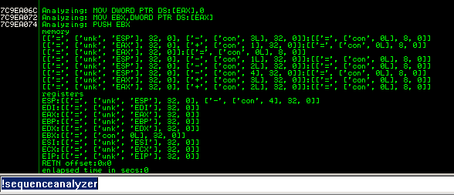
CPU/Memory Context
Notes:
See obvious EBX=0 primitive?

Slide 14
Pieces Analyzer
Summarize the consequences of executing a sequence over our running context
Make hashes of each CPU/Memory change
Calculate a complexity value of each piece
We don't need to deal with instructions anymore, just CPU/Memory state

Slide 15
Consequences
Is a change is the CPU/Memory context
Each piece generate a set of consequences
We can search in our DB for these consequences using the hashes
EBX:[['=', ['con', 0L], 32L, 0L]]:C59756C0
Reg
Value
CRC32

Slide 16
Piece Complexity Index
How complex is this piece?
  how many consequences does it have?
  how many memory operations does it have?
  how much has the stack pointer moved?
MOV EDI,EDI
RETN
MOV EDI,EAX
POP EAX
POP EBX
RETN 4
MOV EAX,[EBX]
POP ECX
RETN 0C
XOR EDI,[EBX+ECX*4]
MOV [EDI], EAX
XOR EAX,EAX
POP ECX
RETN 30
COMPLEXITY

Slide 17
ID Database
Store all module's pieces along with necessary information to replay the sequence
Using the consequence hash we can find suitable pieces quick and easy
And we always get the simpler piece that does the job thanks to the complexity index
Notes:
How do I get the CRC32 value from a thing whatever a consequence is...

Slide 18
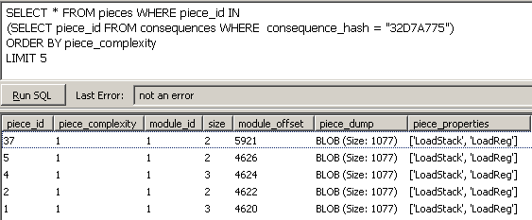
The DB

Slide 19
Data Data everywhere
NTDLL generates ~10,000 pieces
Many pieces have the same consequences
(but we need them to bypass filters)
Processing an average sized library takes 4 hrs
SQL allows us to make arbitrary complex queries
  Find pieces with the same address over a set of modules (universal addresses)
  Use only application specific addresses (independent from the OS)
Notes:
How much data do we get for a sample DLL
NTDLL generates 10000 different pieces
Each piece has many consequences
or different pieces can have the same consequences
Need all possibilities to bypass filters
NTDLL is like 4 hours

Slide 20
DEPLib Parser
Track register use to avoid undesirable overwriting of already settled values (du chains)
It supports variables
It does register reusing over non-overlapped variables
Calculate all possible combinations of variable to register mapping
Notes:
explain DU chains

Slide 21
About the Language
Almost assembler:
  mov, sub, add
  xor, and, or
  shl, shr, rol, ror
  call (using fixed or dynamic stack arguments)
And some useful additions:
  jump to your shellcode
  find your stack stream
    parser.findbuffer(['EAX','+',8])
    means: EIP=[EAX+8], ESP=EAX+12
  find the stack stream end

Slide 22
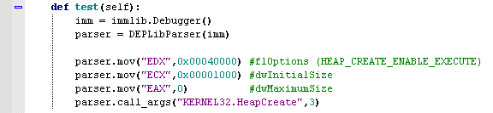
DEPLib Parser Example
Notes:
take care of used registers to avoid that an undesirable consequence modify its value
each variable is a register, it does register reusing for non overlapped variables and it calculate all possible combinations of variable to register mapping

Slide 23
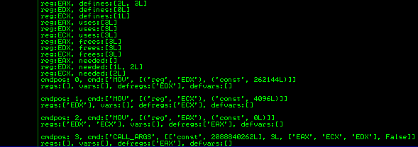
Transformation...
Notes:
explain briefly what's happening here:
- def-use information
- parsed commands

Slide 24
DEPLib Generator
Searches in the database for pieces that generate our desired consequences (we don't use hand-selected addresses, all is done dynamically)
Checks that each piece satisfies a set of preconditions:
  undesired memory writing/reading
  undesired register overwriting
  piece effective address bypass chars filtering
Creates a stack sequence that we need and fills the blanks with good chars

Slide 25
DEPLib Parameters
To start generating our stack stream, we need the following information from the user:
  a DEPLib Parser instance
  a list of allowed modules to get the pieces from
    OS specific?
    Application specific?
    Universal addresses?
  a list of memory addresses where we can read or write (optional)
  a list of bad chars (to bypass chars filtering)

Slide 26
Some tricks...
We need to support loading of arbitrary values to registers (even if they have bad chars)
deplib.mov('EAX', 0x00040000)
DEPLib Language Level
def mov(reg, value):
if value has badchars:
PopPopSubTrick(reg, value)
else:
PopTrick(reg, value)
...
def PopPopSubTrick(reg, value):
(val1,val2) = findSubValues(value)
mov(reg, val1)
reg2 = findFreeReg()
mov(reg2,val2)
sub(reg, reg2)
DEPLib Logic Level
Notes:
ask to the public before showing this slide if they can imagine a way of loading arbitrary values

Slide 27
Some tricks...
MOV EAX,0xFFFFFFFF
MOV EDX,0xFFFBFFFF
SUB EAX,EDX
Assembler Level
Return Programming Level
Stack Memory
77F21564
77F21564 58 POP EAX
77F21565 C3 RETN
FFFFFFFF
77F33A40
77F33A40 5A POP EDX
77F33A41 C3 RETN
FFFBFFFF
77F31293
77F31293 2BC2 SUB EAX,EDX
77F31295 C3 RETN
...
...
...

Slide 28
Metrics
We've obtained a stack stream that successfully and reliably do:
  HeapCreate with the Executable Page option
  Allocate a chunk in this new heap
  Memcpy our shellcode
  Jump to the allocated chunk
  In just 280 bytes, bypassing NULL chars filters
  If you don't have badchars it's half that size
The smallest stream we have created (always bypassing NULL char filtering) is 236 bytes long

Slide 29
DEMO

Slide 30
Future Work
Support the entire x86 instruction set
Interpret flags and do conditional analysis
Support conditional execution and looping on DEPLib to create a Turing-Complete implementation
  Not just for the FUN, but to execute shellcode selectively

Slide 31
The Conclusion
Automatically defeating DEP is not just an idea
is a FACT

Slide 32
Thank you for your time
Contact me at:
pablo.sole@immunityinc.com

